Slide 1

Maine GeoLibrary
Executive Director’s Report
Jay Clark, May 21, 2025

Slide 2

NEWS
We are LIVE in the Azure Cloud.
  Work remains with agencies getting them up and running.
  Public users are reaching out and getting support.
  We are on a steep learning curve and working diligently to smooth it out.
We had a table at the MMA Technology Conference on May 14.
  Claire Lawrences first day was there at the conference; she is with us full time now.
  Our outreach and marketing project is kicked off. We had 20 sign-ups and have scheduled 10 for a teams call next week.
We will be teaching a class on Cadastral data at the Assessor’s Training in June.

Slide 3






A big THANKS
To Clarence and
The OIT team
that has brought
us this far.
Fahed
The future’s so bright we got to wear shades

Slide 4
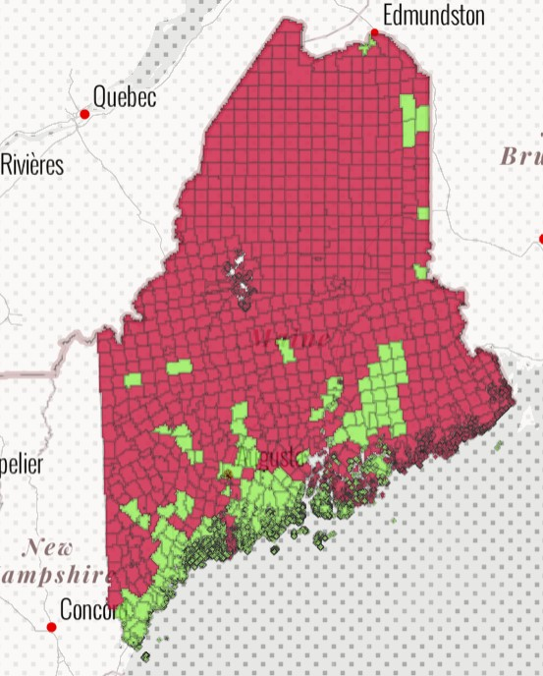
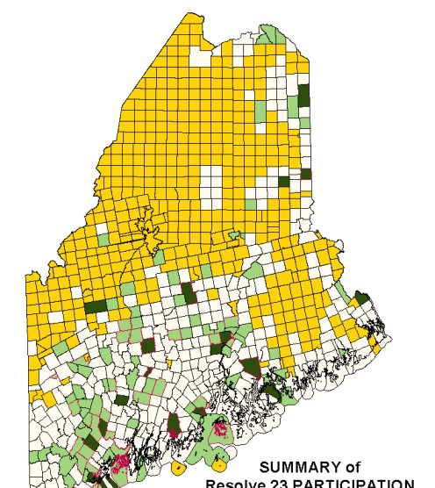
Strategic
&
Program Planning
A Review of the Strategic and Program Plans
and
Recommendations to the Board

Slide 5
Strategic Plan
2025-2028
Maintain and Expand Data Holdings
Update Policies
Inventory data content and reorganize to framework layers
Redesign and rebuild the web site
Improve user management
Maintain legislative relationships
Develop and execute a Board recruitment project

Slide 6

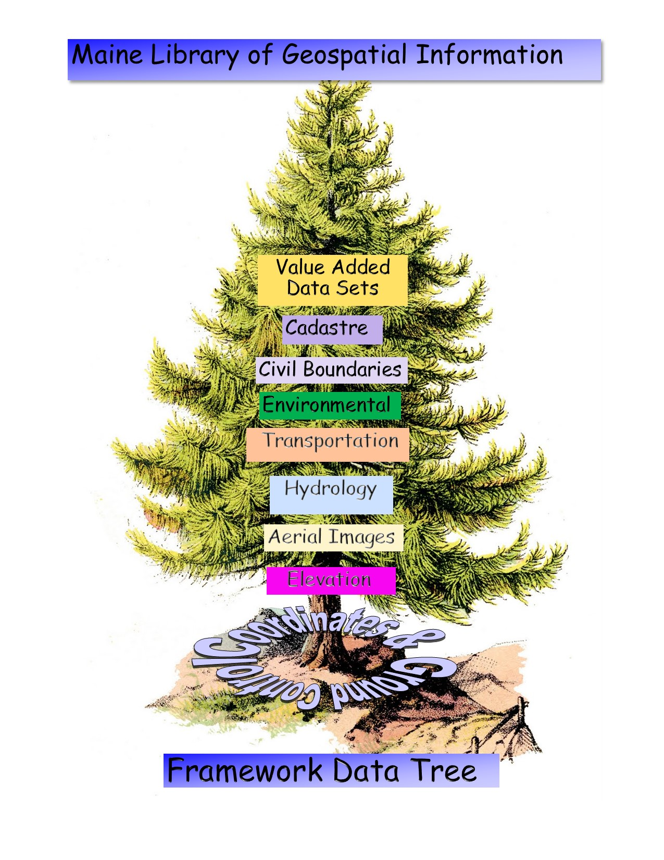
FY25-26
Proposed Program Plan

Slide 7
The Program Plan
Community Data Projects
Technology Projects
Framework Layers
Data Projects

Slide 8
Framework Layers Projects
Realign the presentation of the data catalog to line up with the Framework Tree.
Use ground control layer to qualify accuracy of all other layers.
Provide statewide ortho coverage as specified.
Provide stable elevation modeling with DEM, DSM and DHM rasters.
Add Bathymetry DEM for costal Maine (NOAA).
Determine the best source for Hydrography framework layer and pursue 3DHP project.
Evironmental
Add new Land Cover and Forestry data
Create a transportation layer from 911 Roads and DOT Public Map Viewer.
Create a boundaries layer using US BOC as authoritative source
Create a cadastral layer using tax maps, 911 address points, and structures.

Slide 9
Technology Projects
Complete the platform migration assuring stability, expanded data storage, and computing horsepower
Implement a new web site for the GeoLibrary

Slide 10
Community Projects
Provide an outreach program that effectively communicates the mission and value of the GeoLibrary to the Counties, Cities, and Towns in Maine.
Assure that there is an educational experience available to users of the web site that will aid with inexperienced users and information about the GeoLibrary’s program.

Slide 11
Getting to Yes – Program Approval
Two documents were sent to the Board for review:
  The Strategic Planning Update
    Supports the Board’s Strategic efforts for the next 3 years.
  The Program Plan for FY 25-26
  Defines a set of projects that will be undertaken over the next 2 years, to be updated next April for the next Program year.
Will you accept the Strategic recommendations and the Program Plan?

Slide 12
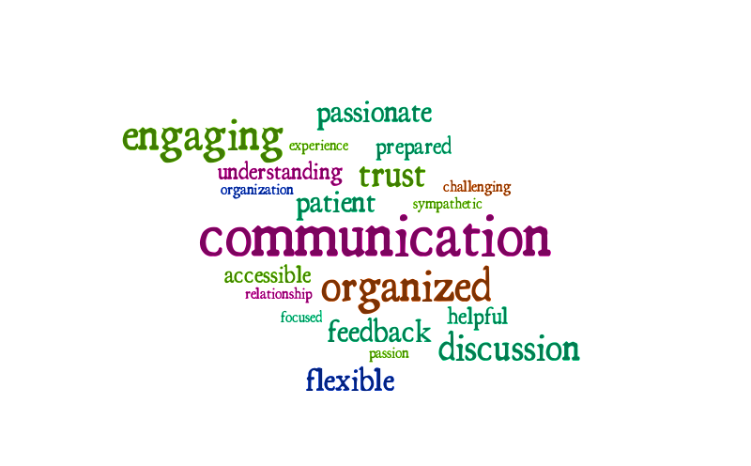
Q&A and Discussion
This Photo by Unknown Author is licensed under CC BY-NC-ND

Slide 13
June Meeting is In-Person at the EMS Building
June 18, 2025, at 1:00 to 3:00 PM
Optional lunch at Britt’s at 12:00.

